Slide 1

Introduction to FIFA World Cup
The FIFA World Cup is an international football tournament attracting teams from around the world to compete for the championship.

Slide 2
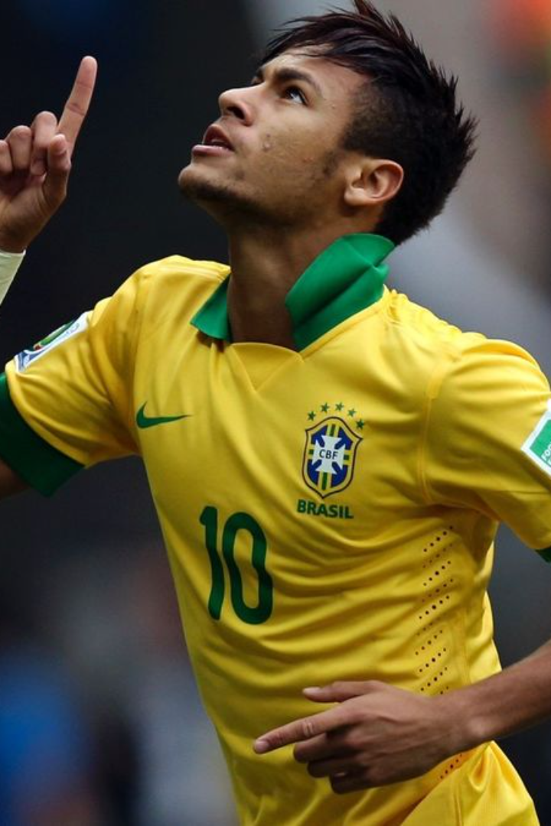
History of the FIFA World Cup
1
Origin
The first FIFA World Cup took place in 1930 in Uruguay, with just 13 teams participating.
2
Expansion
Over the years, the tournament has expanded and grown in popularity, becoming a global spectacle.
3
Significance
It has become one of the most viewed and celebrated sporting events worldwide.

Slide 3
Format and rules of the tournament
Tournament Structure
Rules
The tournament consists of qualification rounds followed by group stages and knockout rounds.
It is governed by FIFA rules including guidelines for player eligibility, match conduct, and disciplinary actions.

Slide 4
Analysis of past World Cup winners
20
5
Countries that have won the World Cup
Most world cup wins by a country

Slide 5



Notable players and teams in World Cup history
Pele
Maradona
Messi
One of the greatest footballers, won multiple World Cups with Brazil.
Famous for his "Hand of God" goal and remarkable dribbling skills.
Argentinian superstar known for his exceptional goal-scoring abilities.

Slide 6




Impact of the World Cup on host countries
Cultural Exchange
Economic Boost
Infrastructure Development
Host cities experience an influx of tourists, promoting cultural exchange and global visibility.
Local businesses benefit from increased tourist activity, boosting the host country's economy.
The World Cup often drives infrastructure improvements, benefiting the host nation in the long term.

Slide 7
Economic and social implications of the tournament
Economic Impact
Creates jobs and stimulates local economies.
Social Implications
Unites people across nations, fostering global camaraderie.

Slide 8

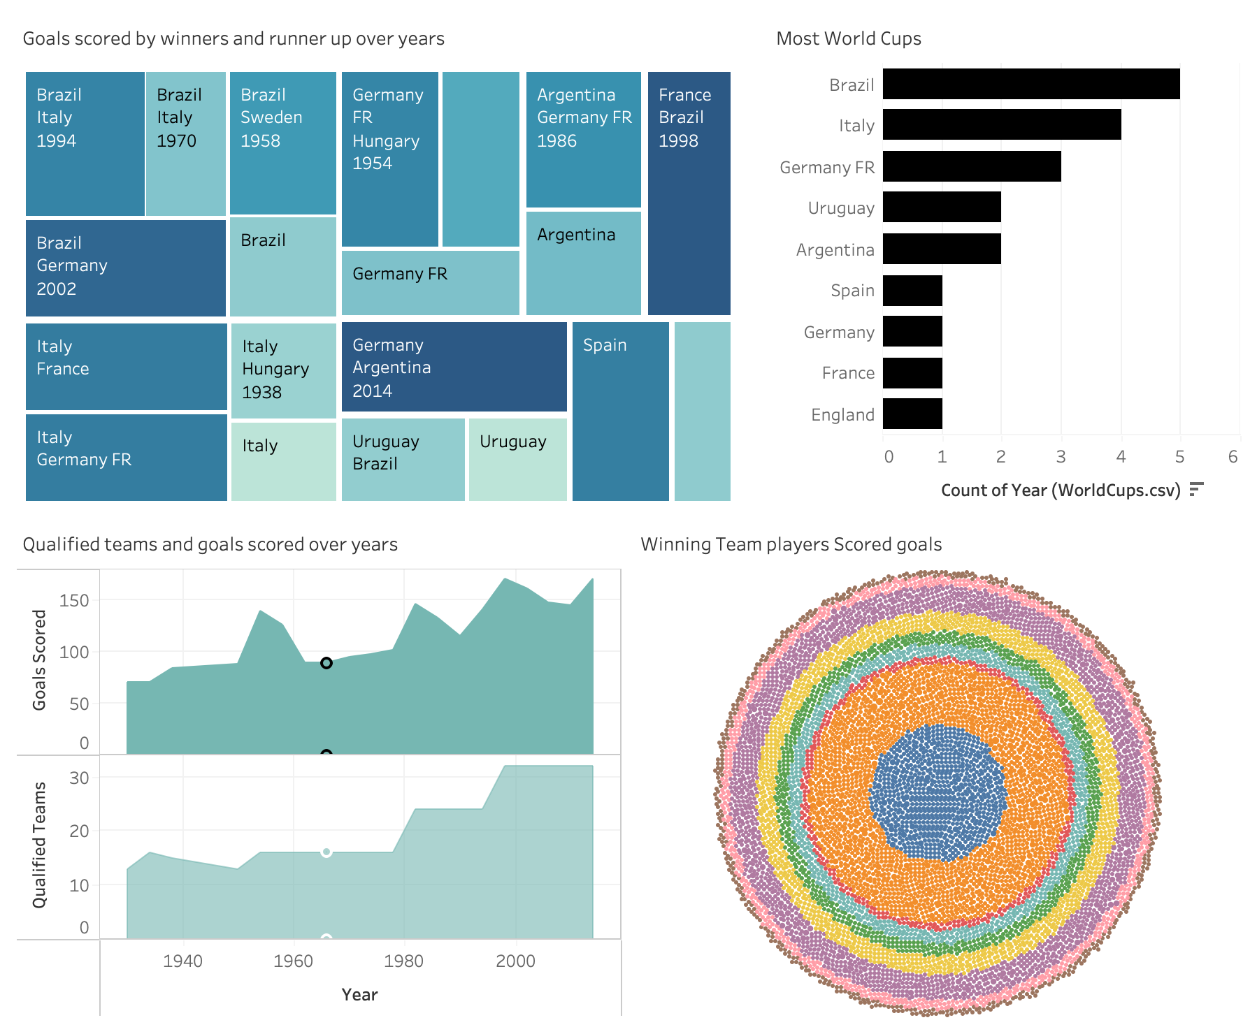
Tableau
Dashboard

Slide 9
Future of the FIFA World Cup
Expansion
Technology
Global Reach
There are discussions about expanding the tournament to involve more teams and matches.
Advancements in VAR (Video Assistant Referee) and other technologies are shaping the future of the game.
The World Cup continues to extend its global reach, captivating audiences worldwide.

